Slide 1
RESEARCH ETHICS AND OUTCOMES
ISTP LECTURE

Slide 2

Ethics In Research
Research as a purely objective activity removed from all aspects of politics and power is a myth no longer accepted in the research world

Slide 3
Ethics In Research
It is now recognized that research, and therefore researchers, are responsible for shaping the character of knowledge (soon after the turn of the 20th century).
So responsibilities associated with this knowledge production have led to a growing recognition and acceptance of the need for ethical and political awareness.

Slide 4
Ethics In Research
Power, politics, and ethics must be actively managed by the researcher.
Researchers need to recognize that power can influence the research process, and that with power comes responsibility.
So, what power involves….

Slide 5



Recognize and appreciate your own reality as a researcher.
Be cognizant of how your worldview, assumptions, and position can influence the research process.
Act ethically : balances the biases and subjectivities

Slide 6
Ethics In Research
Ethnicity: ethnic and cultural background of the researcher can influence the research process.
Social status: Our position in society can have great bearing on the research process.
Education: It is important for researchers to consider how respondents will relate to them.

Slide 7
Ethics In Research
Yet you are likely to be better educated than many you will be researching – the power position.
Field-based researchers often learn that building trust and friendly relation grows from their ability to show respect for the researched regardless of any educational differential.

Slide 8
Acting within the law :
All research must abide by common law.
Researchers also need to consider whether there is an obligation to report any illegal activities they may become aware of in the course of their research.
If your research is likely to contend with illegal activities, getting the advice and approval of an appropriate ethics committee is imperative.

Slide 9
Responsibility for the researched:
Responsibility for the dignity,respect,and welfare of respondents, both mentally and physically, is central to research ethics.
Respecting the rights of cultural groups:
Certain aspects of research may be deemed culturally inappropriate. In Aboriginal cultures in Australia, for example, it is offensive to look at images of the deceased. A research project that asked this of Aboriginal respondents would not be acceptable.

Slide 10
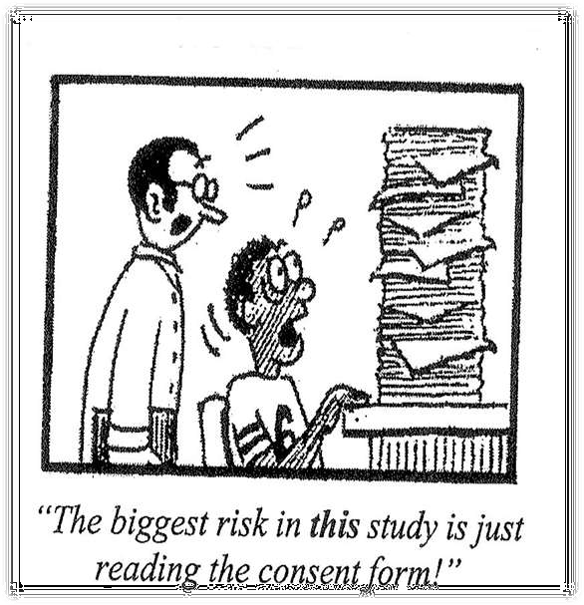
Responsibility for the researched:
Ensuring respondents have given informed consent:
Informed consent emphasizes the importance of researchers accurately informing respondents/participants of the nature of their research.

Slide 11
Informed consent:
Informed consent implies that participants are:
 Competent – they have the intellectual capacity and psychological maturity necessary to understand the nature of the research and their involvement in the study.
Autonomous – they are making self-directed and self- determined choices.
Involved voluntarily – they must be made aware of the research being conducted.
Aware of the right to discontinue – participants are under no obligation to continue their involvement, and pressure to continue should not be applied.

Slide 12
Informed consent:
Not deceived – researchers need to be honest about the nature of their research, about the affiliation or professional standing, and the intended use of their study.
Not coerced – positions of power should not be used to get individuals to participate in a study.
Not induced – an offer of money or some other reward that entices individuals to participate in research that they would otherwise avoid is considered inducemen.

Slide 13
ABUSE IN RESEARCH:
The concept of harm in social science research generally refers to emotional or psychological harm, rather than physical harm.
Asking participants to engage in research that sparks resentment, causes fear or anxiety, is demeaning or embarrassing.
Some research texts refer ‘potential benefits outweighing potential harm’.

Slide 14
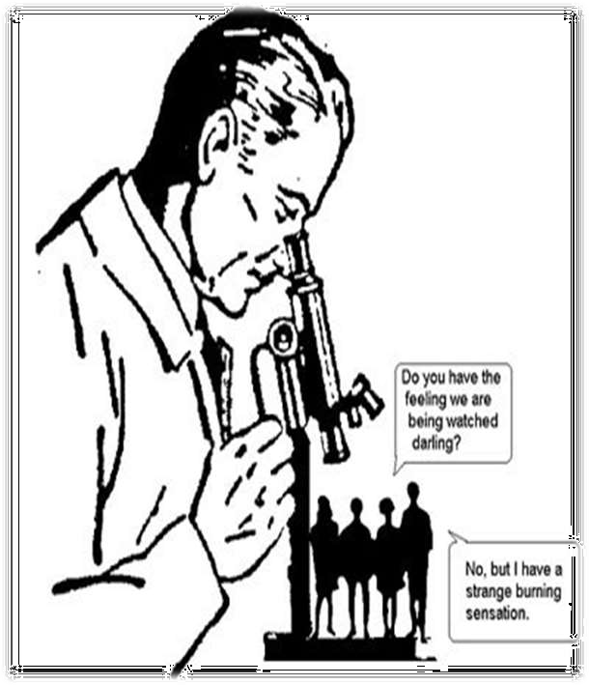
ABUSE IN RESEARCH:
Regardless of any potential benefits to society, or even informed consent, risks of any type of harm, including damage to self-esteem or self-respect, should be ethically and/or morally unacceptable.

Slide 15
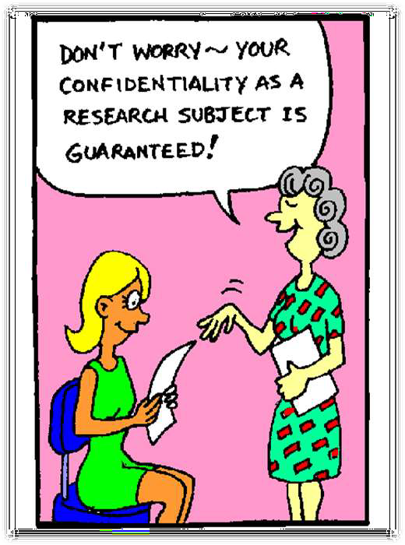
Ensuring confidentiality:
Confidentiality involves protecting the identity of those providing research data.
Protection of confidentiality may involve secure storage of data; restricting access to raw data; obtaining permission for subsequent use of data; publication of research findings in a manner that does not allow for ready identification of subjects; and eventual destruction of raw data.

Slide 16
Anonymity:
Anonymity goes a step beyond confidentiality and refers to protection against identification from even the researcher.
Information, data, and responses that are collected anonymously cannot be identified with a particular respondent.

Slide 17
STORING DATA
COLLECTION AND STORAGE OF DATA:
The collection and storage of data must be secure
--Are my files/computer password protected? How can security be assured in the ‘field’?
DISSEMINATION: Researchers have a duty to disseminate their research findings to all appropriate parties
– …a summary of findings, available on email request, would suffice.

Slide 18
Potential pitfalls for teams
Participant/community fatigue
- repeated interviews with same subjects
- few tangible results for participants
- inflated expectations of participants
- local impression/reputation of the IIT

Slide 19
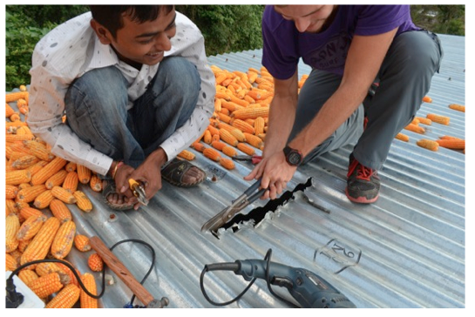
Impact on property?

Slide 20
Impact on local values/traditions
Change is not always good
Technology is not always better
Sometimes teams will find that the problem is not a problem. Or that no action is needed.
Notes:
Or that alternatives or solutions are simply not available at this time.

Slide 21
Failure reports
We can learn from our failures. Hamdallaye case study in Mali:
Aid-sponsored wind energy project
Supplied equipment and wiring
Failed to consider environmental issues
Failed to consider community need

Slide 22
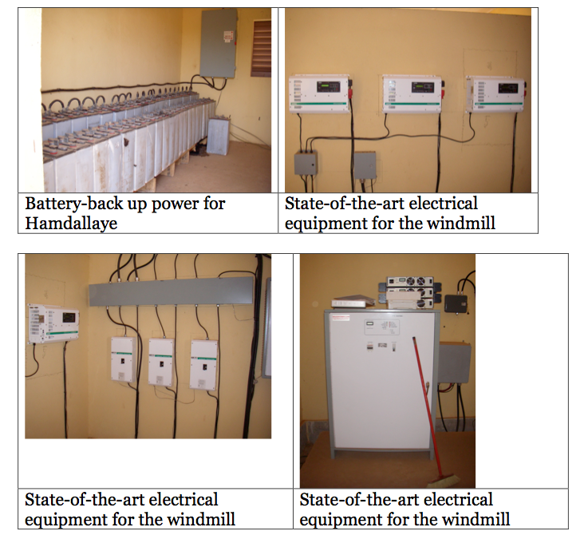
High tech infrastructure, but never functioned properly

Slide 23
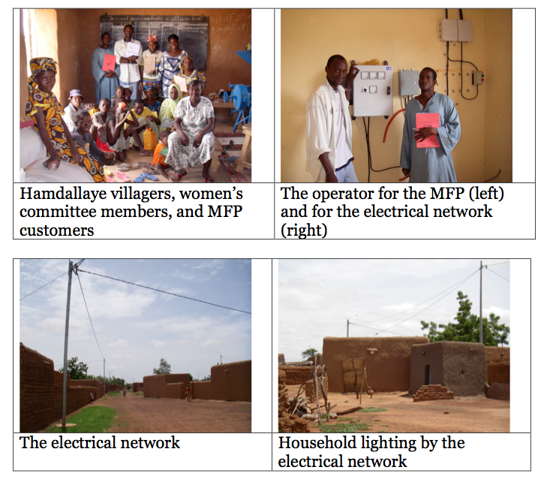
Committees were set up, but not carefully consulted

Slide 24
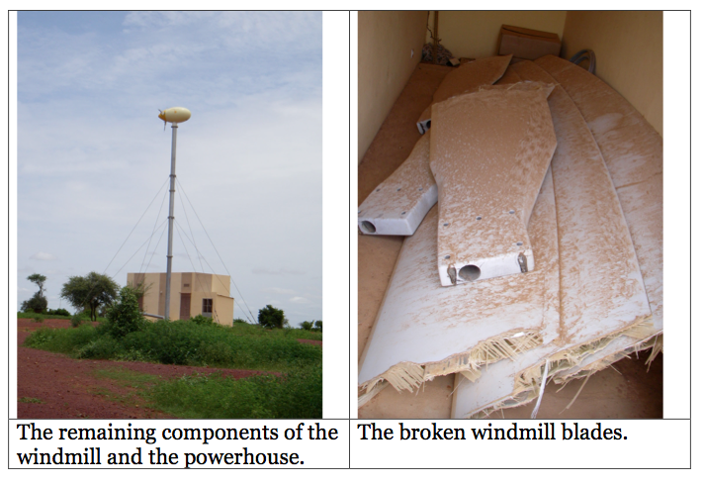
End result
In fact, the villagers were more concerned and needed access to water not electricity. Water is a fundamental need while electricity is seen very often as a luxury. Unfortunately, the village was not included in the process, resulting in over $500,000 CDN of unused equipment and a village suffering from beneficiary fatigue and mistrust.
Notes:
Variable wind speeds were not taken into consideration. Sand clogged the mechanisms. The local community was not able to sustain the costs.

Slide 25
Best Outcome
What students learn, in addition to being willing to work hard and embrace intellectual complex challenges, is compassion for the human condition. The capacity to become good global citizens.
Notes:
Most important outcome is to the community, not the grade.

